Slide 1

Deep Neural Networks
Learning Objectives
Describe the successive block structure of a deep neural network
Build a deep L-layer neural network
Analyze matrix and vector dimensions to check neural network implementations
Use a cache to pass information from forward to back propagation
Explain the role of hyperparameters in deep learning

Slide 2
Deep Neural Networks
1 Deep L-layer Neural network
2 Forward Propagation in a Deep Network
3 Getting your matrix dimensions right
4 Why deep representations?
5 Building blocks of deep neural networks
6 Forward and backward propagation
7 Parameters vs Hyperparameters
8 What does this have to do with the brain?

Slide 3
Deep Neural Networks
Deep L-layer Neural network

Slide 4
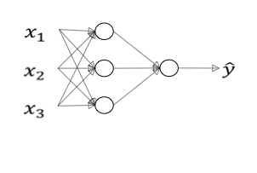
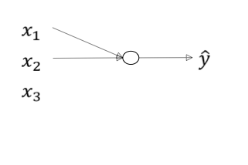

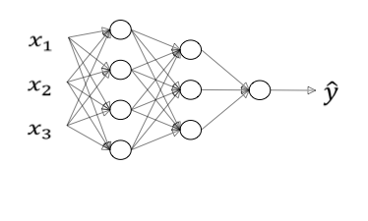
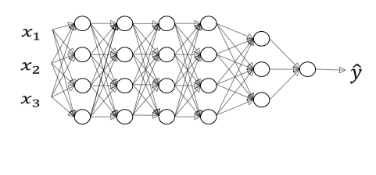
What is a deep neural network?
“Shallow”
“2 layer” NN
logistic regression
1 hidden layer
Deep
2 hidden layers
5 hidden layers

Slide 5
Deep neural network notation
Deep neural networks have multiple hidden layers and can learn functions that shallower models cannot.
The notation used for deep neural networks:
- l, the number of layers
- n^{[l]}, the number of nodes in layer l
- a^{[l]} is the activation in layer l
- W^{[l]} are the weights for computing the value z^{[l]} in layer l
- b^{[l]} is used to compute z^{[l]}.
- The input features are called x
- ŷ is the predicted output of the neural network.

Slide 6
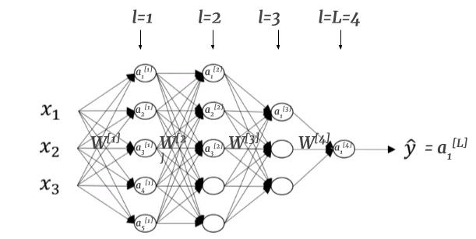
Deep neural network notation

Slide 7
Deep Neural Networks
Forward Propagation in a Deep Network

Slide 8
Forward Propagation in a Deep Network
Forward propagation is the process of computing the output of a deep neural network given an input. Here are the general rules of forward propagation in a deep network:
Each neuron in a layer is connected to every neuron in the next layer.
The output of each neuron in a layer is computed by applying a non-linear activation function to the weighted sum of the inputs to that neuron.
The weights connecting the neurons in each layer are learned through a process called backpropagation, which involves calculating the gradient of the loss function with respect to the weights and updating them using an optimization algorithm like stochastic gradient descent.

Slide 9
Forward Propagation in a Deep Network
The input to the network is fed into the first layer of neurons, which compute their outputs using the input and the weights connecting them to the input layer.
The outputs of the neurons in the first layer are then fed into the next layer of neurons, which compute their outputs using the outputs of the previous layer and the weights connecting them.
This process continues until the output of the final layer is computed, which represents the output of the network given the input.

Slide 10
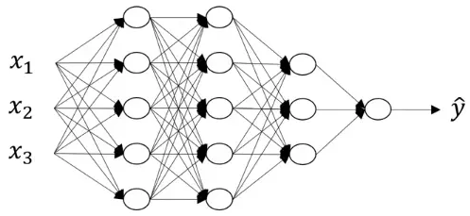









Forward Propagation in a Deep Network
Do the calculation with each hidden layer → output layer is similar to neural network with 2 layers.
Hidden layer 1:
Hidden layer 2:
Generalization for layer n:
Perform vectorization for all training examples for l = 1..L
Where

Slide 11
Deep Neural Networks
Getting your matrix dimensions right

Slide 12
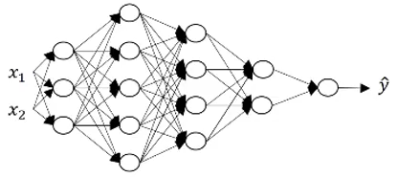
Getting your matrix dimensions right
Analyzing the dimensions of a matrix is one of the best debugging tools to check how correct our code is. We will discuss what should be the correct dimension for each matrix in this section. Consider the following example:
There are 4 hidden layers and 1 output layer. The units in each layer are:

Slide 13
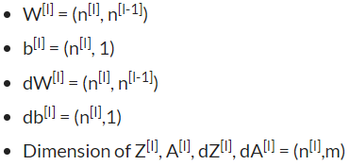
Getting your matrix dimensions right
The generalized form of dimensions of W, b and their derivatives is:
where ‘m’ is the number of training examples. These are some of the generalized matrix dimensions which will help you to run your code smoothly.

Slide 14
Deep Neural Networks
Why deep
representations?

Slide 15


Intuition about deep representation
In deep neural networks, we have a large number of hidden layers. What are these hidden layers actually doing? To understand this, consider the below image:
Y
Deep neural networks find relations with the data (simpler to complex relations). What the first hidden layer might be doing, is trying to find simple functions like identifying the edges in the above image. And as we go deeper into the network, these simple functions combine together to form more complex functions like identifying the face. Some of the common examples of leveraging a deep neural network are:
Face Recognition
Image ==> Edges ==> Face parts ==> Faces ==> desired face
Audio recognition
Audio ==> Low level sound features like (sss, bb) ==> Phonemes ==> Words ==> Sentences

Slide 16
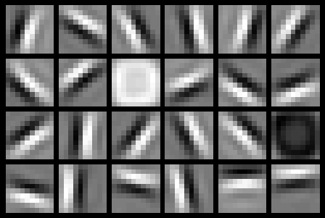
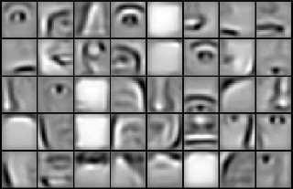
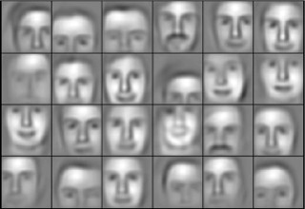
Intuition about deep representation
Y

Slide 17
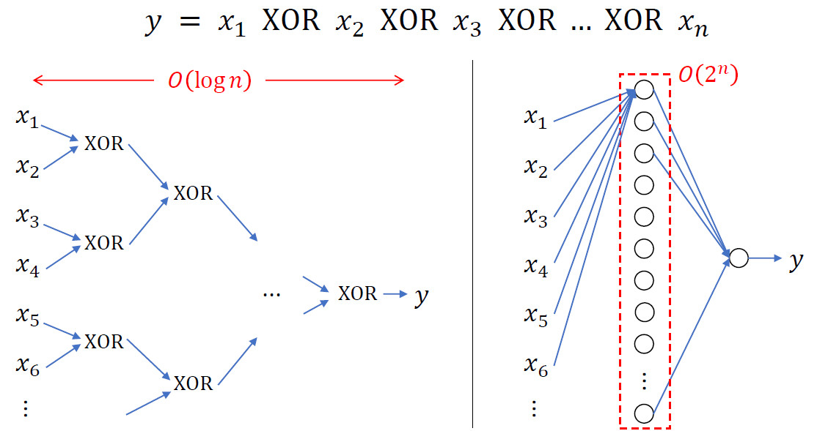
Circuit theory and deep learning
Informally: There are functions you can compute with a “small” L-layer deep neural network that shallower networks require exponentially more hidden units to compute.
For example, computing the exclusive OR function requires exponentially more hidden units in a shallow network than in a deep network. This result highlights the advantages of having a deep architecture in neural networks.

Slide 18
Circuit theory and deep learning
In practice, it is important to find the right depth for a neural network. Starting with a simple model like logistic regression and gradually adding hidden layers can help find the optimal depth for a given problem. However, for some applications, very deep neural networks with many dozens of layers can be the best model.
To implement deep neural networks, both forward and backward propagation need to be implemented.
Notes:
In practice, it is important to find the right depth for a neural network. Starting with a simple model like logistic regression and gradually adding hidden layers can help find the optimal depth for a given problem. However, for some applications, very deep neural networks with many dozens of layers can be the best model.
To implement deep neural networks, both forward and backward propagation need to be implemented. Forward propagation involves computing the output of the neural network for a given input, while backward propagation involves computing the gradients of the parameters of the network with respect to a loss function. These gradients are then used to update the parameters of the network during training via optimization algorithms like gradient descent.

Slide 19
Deep Neural Networks
Building blocks of deep neural networks

Slide 20
Forward and backward functions
Consider any layer in a deep neural network. The input to this layer will be the activations from the previous layer (l-1), and the output of this layer will be its own activations.
Input: a^{[l-1]}
Output: a^{[l]}
This layer first calculates the z^{[l]} on which the activations are applied. This z^{[l]} is saved as cache. For the backward propagation step, it will first calculate da^{[l]}, i.e., derivative of the activation at layer l, derivative of weights dw^{[l]}, db^{[l]}, dz^{[l]}, and finally da^{[l-1]}. Let’s visualize these steps to reduce the complexity:

Slide 21
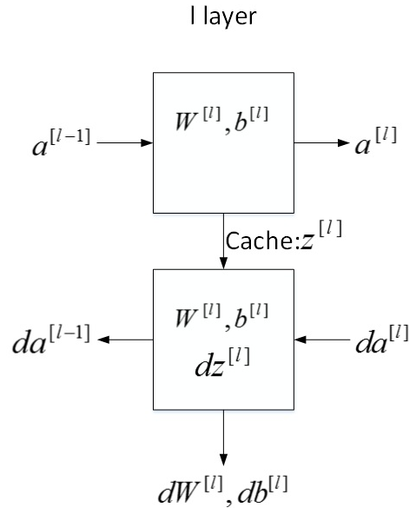
Forward and backward functions

Slide 22
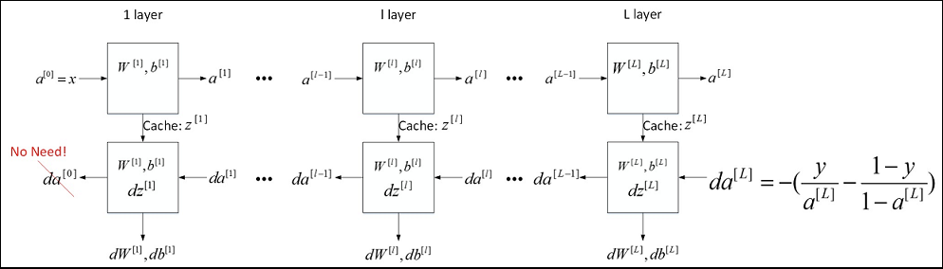
Forward and backward functions
The overall process of training the neural network involves feeding in the input features (a^{[0]}), using forward propagation to compute the output (ŷ), and then using back propagation to compute the derivatives with respect to the parameters and activations of each layer. The cache stores not only the value of z for the backward function but also the parameters (w and b) for convenience in implementation.
Notes:
The overall process of training the neural network involves feeding in the input features (a^{[0]}), using forward propagation to compute the output (ŷ), and then using back propagation to compute the derivatives with respect to the parameters and activations of each layer. The parameters are updated using the computed derivatives, and this process is repeated for multiple iterations until the loss is minimized. The cache stores not only the value of z for the backward function but also the parameters (w and b) for convenience in implementation.

Slide 23
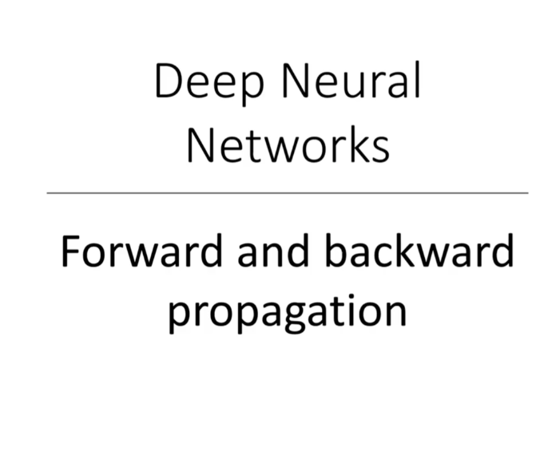

Slide 24
Forward propagation for layer l
Input: a^{[l-1]}
Outputs: a^{[l]} and cache z^{[l]}, which is a function of w^{[l]} and b^{[l]}.
So, the vectorized form to calculate Z^{[l]} and A^{[l]} is:
Z^{[l]} = W^{[l]} * A^{[l-1]} + b^{[l]}
A^{[l]} = g^{[l]}(Z^{[l]})
We will calculate Z and A for each layer of the network. After calculating the activations, the next step is backward propagation, where we update the weights using the derivatives.

Slide 25
Backward propagation for layer l
Input: da^{[l]}
Output: da^{[l-1]}, dW^{[l]} and db^{[l]}.
Let’s look at the vectorized equations for backward propagation:
dZ^{[l]} = dA^{[l]} * g'^{[l]}(Z^{[l]})
dW^{[l]} = 1/m * (dZ^{[l]} * A^{[l-1]}.T)
db^{[l]} = 1/m * np.sum(dZ^{[l]}, axis = 1, keepdims = True)
dA^{[l-1]} = w^{[l]}.T * dZ^{[l]}

Slide 26
Forward and backward propagation
Deep Neural Networks perform surprisingly well (maybe not so surprising if you’ve used them before!). Running only a few lines of code gives us satisfactory results. This is because we are feeding a large amount of data to the network and it is learning from that data using the hidden layers.
Choosing the right hyperparameters helps us to make our model more efficient. We will cover the details of hyperparameter tuning in the next article of this series.

Slide 27
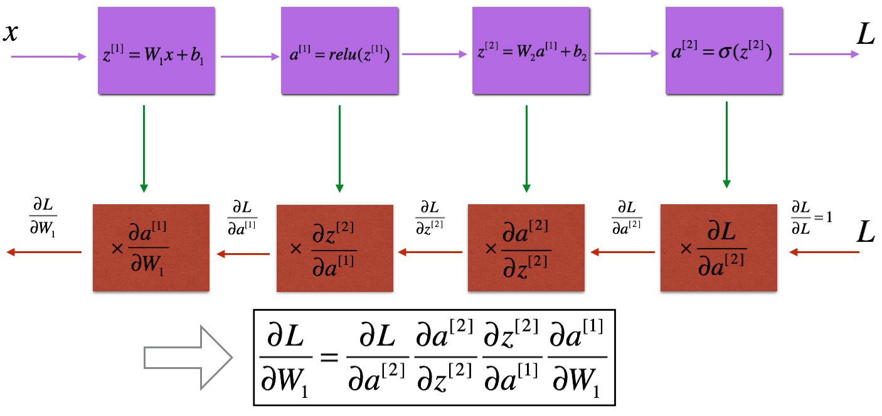
Summary

Slide 28
Deep Neural Networks
Parameters vs Hyperparameters

Slide 29
What are hyperparameters?
Hyperparameters are parameters that are not learned by the neural network itself, but rather are set by the programmer or data scientist during the training process.
These parameters control the behavior of the training algorithm, such as
Learning rate – ⍺
Number of iterations
Number of hidden layers
Units in each hidden layer
Choice of activation function

Slide 30
What are hyperparameters?
They ultimately determine the final value of the learned parameters W and B of the neural network.
Parameters of a deep neural network are W and b, which the model updates during the backpropagation step.
The major difference between parameters and hyperparameters is that parameters are learned by the model during the training time, while hyperparameters can be changed before training the model.

Slide 31
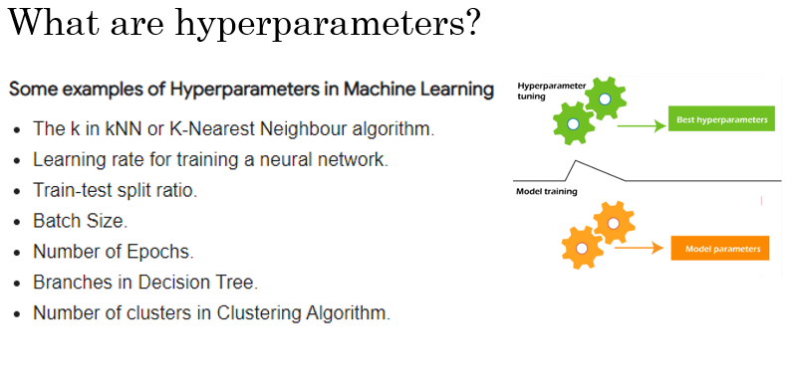

Slide 32
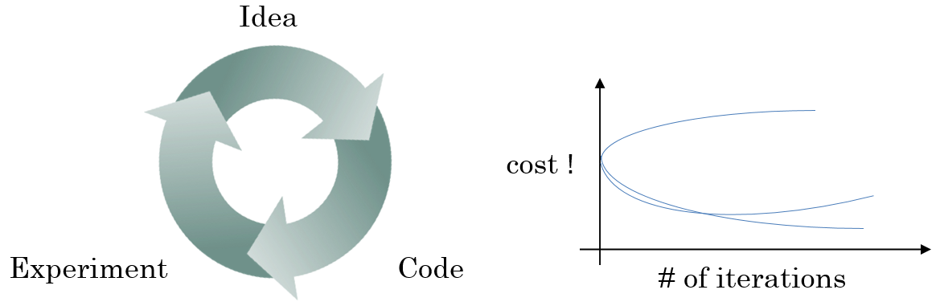
Applied deep learning is a very empirical process
In deep learning, there are many hyper parameters that need to be set, and the best values for these hyper parameters are often not known in advance. Therefore, it is an empirical process to try out different values and see what works best for a particular application. This can involve trying out many different values and iterating until the best set of hyper parameters is found.

Slide 33
Applied deep learning is a very empirical process
Additionally, the best set of hyper parameters for a particular application can change over time, so it is important to periodically re-evaluate and adjust these parameters as necessary.
While there are some systematic ways to explore the space of hyper parameters, deep learning research is still advancing in this area and better guidance for the best hyper parameters to use may emerge over time.

Slide 34
Deep Neural Networks
What does this have to do with the brain?

Slide 35
Forward and backward propagation
While neural networks do have some loose similarities to biological neurons, this analogy is oversimplified and not entirely accurate.
Even neuroscientists do not fully understand the workings of a single neuron, and it is unknown whether the human brain uses an algorithm like backpropagation or gradient descent to learn.
Therefore, deep learning is focused on learning complex input-output mappings, and the analogy to the brain is breaking down as the field progresses.

Slide 36
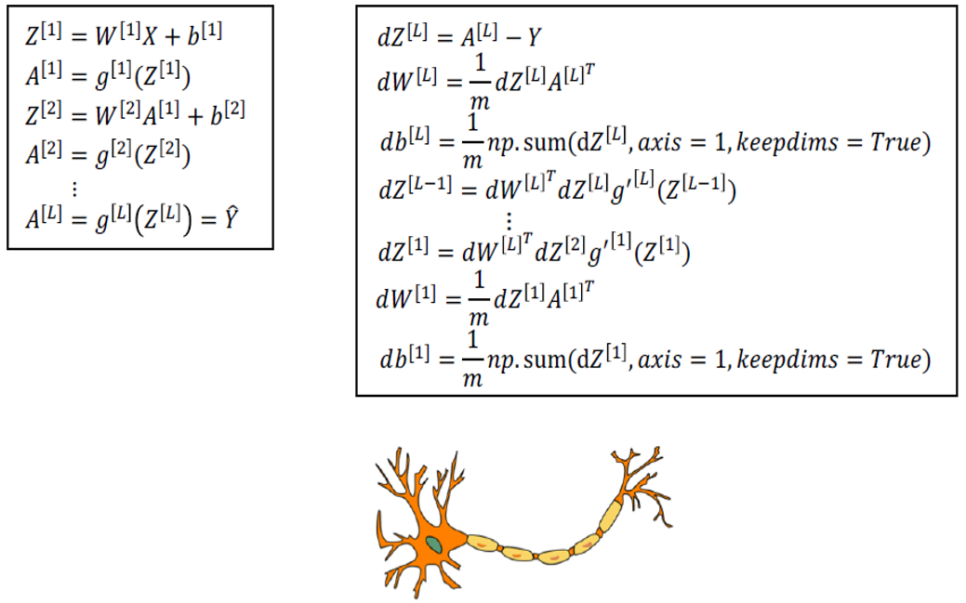
Forward and backward propagation
Forward propagation
Backward propagation

Slide 37
Summarization
Deep neural networks have multiple layers of interconnected neurons (L). Information flows from input through hidden layers to the output layer.
Forward propagation computes predictions by activating neurons using learned parameters.
Ensuring correct matrix dimensions is crucial for efficient computations.
Deep networks learn complex representations from raw data, capturing intricate patterns.
Fundamental components include neurons, layers, activation functions, and parameters.
Forward propagation predicts, while backward propagation updates parameters during training.
Parameters (weights and biases) are learned, while hyperparameters (learning rate, layers) control learning and are set before training.
Deep neural networks draw inspiration from the structure and functioning of the human brain, mimicking synapses and adaptation.
Notes:
Deep L-layer Neural Network:
- A type of artificial neural network with multiple layers (L) of interconnected neurons.
- Information flows from input through hidden layers to the output layer.
Forward Propagation in a Deep Network:
- The process of passing input data through the network to compute predictions.
- Involves computing activations of neurons in each layer using learned parameters.
Getting Your Matrix Dimensions Right:
- Ensuring correct matrix dimensions is crucial for efficient computations and error-free training.
Why Deep Representations?
- Deep networks can learn complex and abstract representations (deep representations) from raw data.
- Enables capturing intricate patterns and relationships in the data.
Building Blocks of Deep Neural Networks:
- Neurons, layers, activation functions, and parameters are the fundamental components.
Forward and Backward Propagation:
- Forward propagation for prediction.
- Backward propagation (backpropagation) for parameter updates during training.
Parameters vs. Hyperparameters:
- Parameters (weights and biases) are learned during training.
- Hyperparameters (learning rate, layers, neurons) control the learning process and are set before training.
What Does This Have to Do with the Brain?
- Deep neural networks are inspired by the structure and functioning of the human brain.
- Connections and learning process in artificial neural networks mimic synapses and adaptation in the brain

